Slide 1
Sets
Computer Science 3

Slide 2
Java Interfaces
The following are important interfaces included in the Java framework:
Collection
Set
Map

Slide 3
Java Collections
Map
Sub
Interfaces
-extends
Collection
Implementing
Classes
SortedMap
Sub
Interfaces
-extends
HashMap
HashTable
Implementing
Classes
List Set
Sub
Interfaces
-extends
Implementing
Classes
TreeMap
SortedSet
Implementing
Classes
ArrayList
LinkedList
Vector
TreeSet
AbstractSet
HashSet
LinkedHashSet

Slide 4
Collection Interface
The Collection interface is the parent of List
and Set. The Collection interface has many methods listed including add(), clear(), remove(), and size().
Collection
List
Set
others not shown

Slide 5
Set Interface
The Set interface extends the Collection interface.
Set
HashSet
SortedSet
TreeSet

Slide 6
What is a set?
A set is a group of items all of the same type of which none are duplicates.
Common operations :
Union
Intersection Difference or Relative Complement
Size or Cardinality

Slide 7
What is a set?
Union - combing the elements
[5, 7, 9] U [9, 11, 13]
Results in [5, 7, 9, 11, 13]

Slide 8
What is a set?
Intersection - same elements
[5, 7, 9] ∩ [9, 11, 13]
Results in [ 9 ]

Slide 9
What is a set?
Difference or Relative Complement
[5, 7, 9] \ or - [9, 11, 13]
Results in [5, 7]
In one, but not in two

Slide 10
What is a set?
Size or Cardinality
[1, 3, 5, 7, 9] == 5
[9, 11, 13] == 3
The number of elements in the set

Slide 11
Java Set
Because Set is an interface, you cannot instantiate it.
Set bad = new Set(); //illegal
Set hash = new HashSet(); //legal
Set tree = new TreeSet(); //legal
hash and tree store Object references

Slide 12
Java Set
With Java 5, you can now specify which
type of reference you want to store in the TreeSet or HashSet.
Set<Byte> bytes = new TreeSet<Byte>();
Set<Student101> its = new HashSet<Student101>();

Slide 13
Java Set
HashSet – a set ordered by each
item’s hashCode that is extremely time efficient.
TreeSet – a naturally ordered set that is very efficient, but not as efficient as HashSet.

Slide 14
What is a hash table?
HashSet and HashMap were both
created around hash tables.
A hash table is essentially a giant array. Each item is inserted into the array
according to a hash formula.
0 1 2 3 4

Slide 15
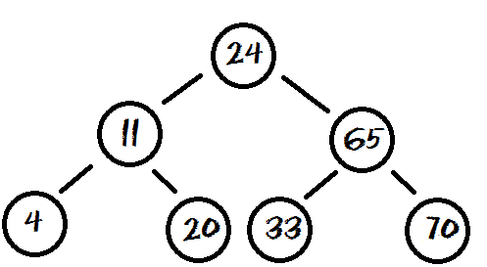
What is a binary tree?
TreeSet and TreeMap were built around binary trees.
A Binary Tree is a group of nodes that contain left and right references. Each item is inserted into the tree according to its relationship to the other nodes.

